Slide 1
Life at War
The American Battlefield Trust

Slide 2
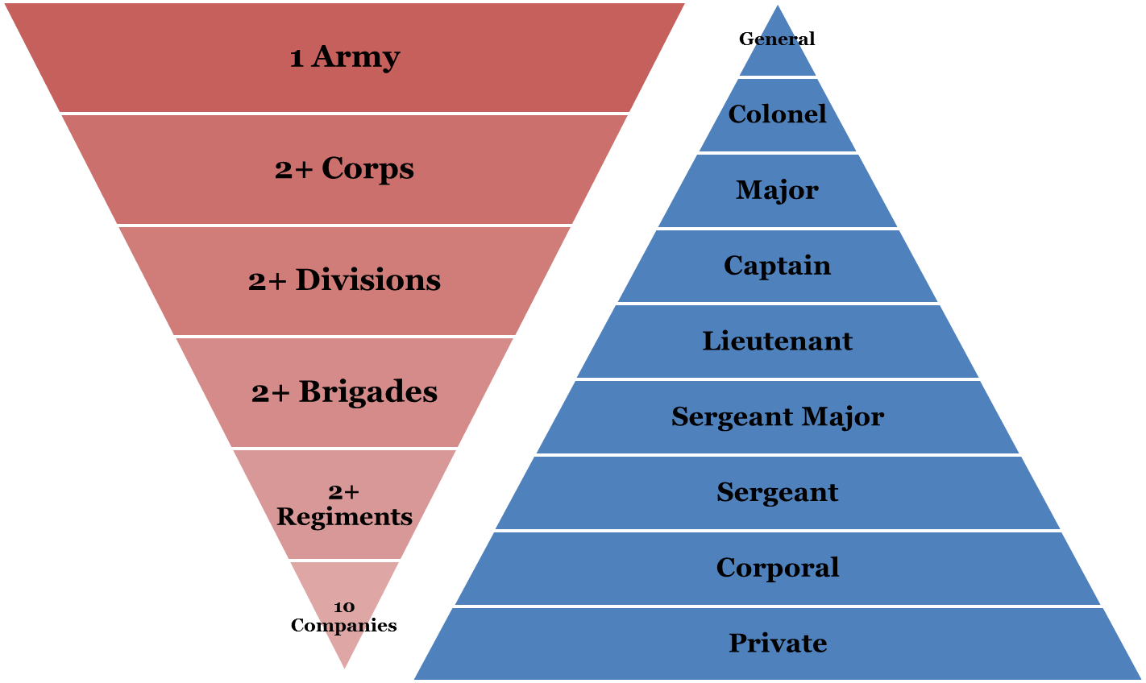
Army Organizations & Military Ranks
Notes:
This slide illustrates the organization of armies during the Civil War. Most men were privates and part of a much larger army.
On the left you can see how soldiers were grouped to make an army. 1 company = 100 men. 1 regiment = 1,000 men. 1 brigade =
2,000 or more men. 1 division = 4,000 or more men. 1 corps = 8,000 or more men. 1 army = 16,000 or more men. The size and make
up of these organizations will fluctuate during the war.
On the right you can see the hierarchy of rank.
Discussion:
Do you think that most men were noticed?
How do you think privates were treated?
How do you think generals were treated?

Slide 3
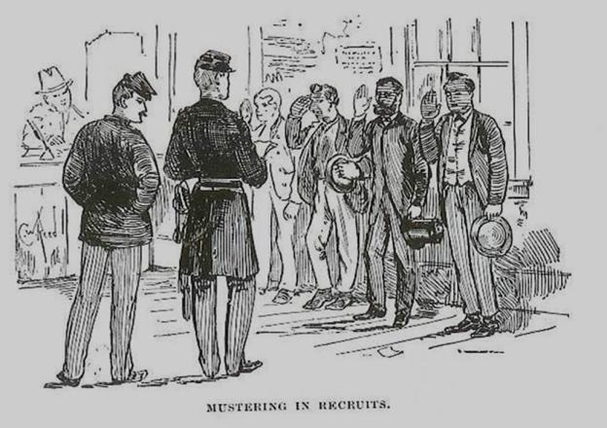
The Average Soldier
Notes:
Enlisting/signing up to fight --the men came from factories and farms, North & South to fight in the Civil War

Slide 4
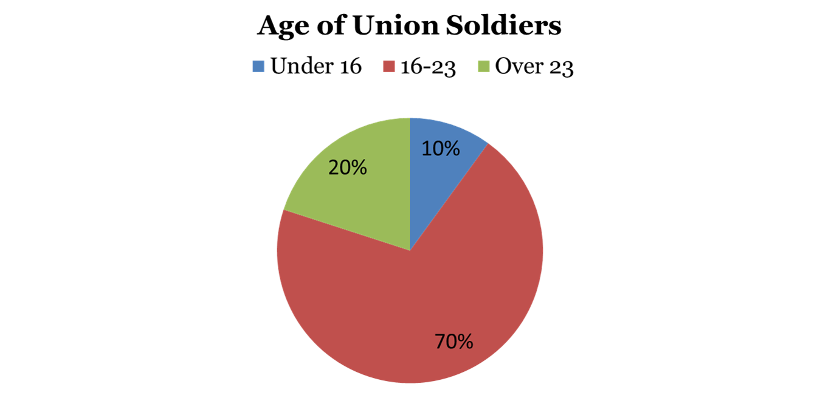
The Average Soldier
They were old and young, but mostly young…
Notes:
Discussion:
Why do you think the Civil War is sometimes called the “Boys’ War?”
How many Union Soldiers were under 16?
How many soldiers were between 16 and 23?
How many were over 23?
Do you think most soldiers in the Confederate army would have been older or younger? Why?

Slide 5
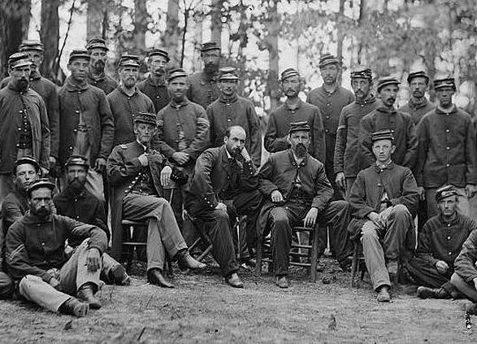
The Average Soldier
Notes:
The average Yank or Reb was white, native-born, farmer, protestant, single, between 18 and 29. He stood about 5 feet 8 inches tall and weighed about 143 pounds. Most soldiers were between the ages of 18 and 39 with an average age of 25.
Slang – Reb and Yank may be terms that you have not yet discussed with your students.
Reb = rebel, confederate, or southern soldier
Yank = yankee, federal, union, or northern soldier

Slide 6
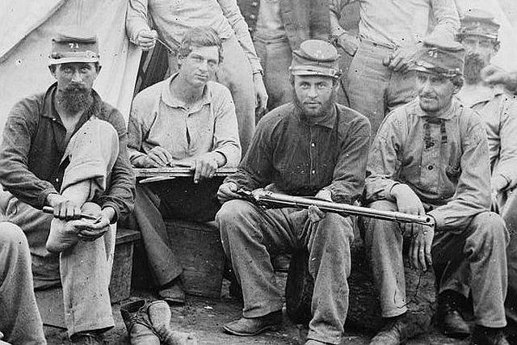
Why They Fought
Notes:
Men on both sides were inspired to fight by patriotism, state pride, the chance for adventure, or steady pay. The common Union soldier tended to fight to preserve the Union while the common Confederate soldier tended to fight to defend his home.
Discussion:
Why would a Confederate soldier be defending his home and a Union soldier not be?
Answer information - the war was mainly fought in the South. Union troops initially moved South to put down the rebellion. In the North, Maryland, Kentucky, Missouri and Pennsylvania saw major battles.

Slide 7
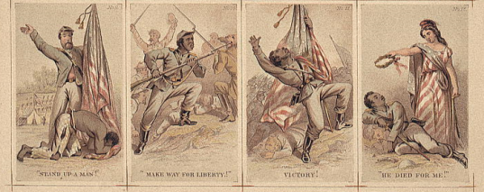
Why They Fought
Notes:
Following the Emancipation Proclamation African Americans could join the US Armed Forces.
Approximately 180,000 African Americans comprising 163 units served in the Union Army during the Civil War, and many more African Americans served in the Union Navy.
If your students have not yet watched Black Soldiers In4, this could be a good video to show. https://www.civilwar.org/learn/videos/black-soldiers-civil-war
Discuss:
Why might a former slave want to fight for the Union Army?
Do you think that this had special meaning for that individual?
How do you think African American troops were treated by other Union soldiers? (Answer information: Generally not kindly, while the North did not have a significant slave population, there was still deep seeded racism.)
Do you think African American troops served side-by-side with white troops? Or camped with white troops? [Answer information: No, USCT (United States Colored Troops) were placed in separate regiments with white commanding officers]

Slide 8
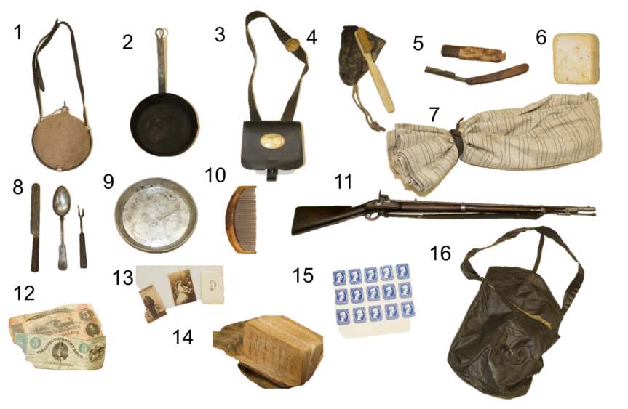
What They Carried
Notes:
1.Canteen
2.Pan
3.Cartridge box (Union)
4.Tooth brush
5.Razor
6.Soap
7.Blanket
8.Silverware
9.Plate
10.Comb
11.Musket
12.Money (Confederate)
13.Photographs
14.Bible
15.Stamps (Confederate, Jefferson Davis prints)
16.Haversack (Union)

Slide 9
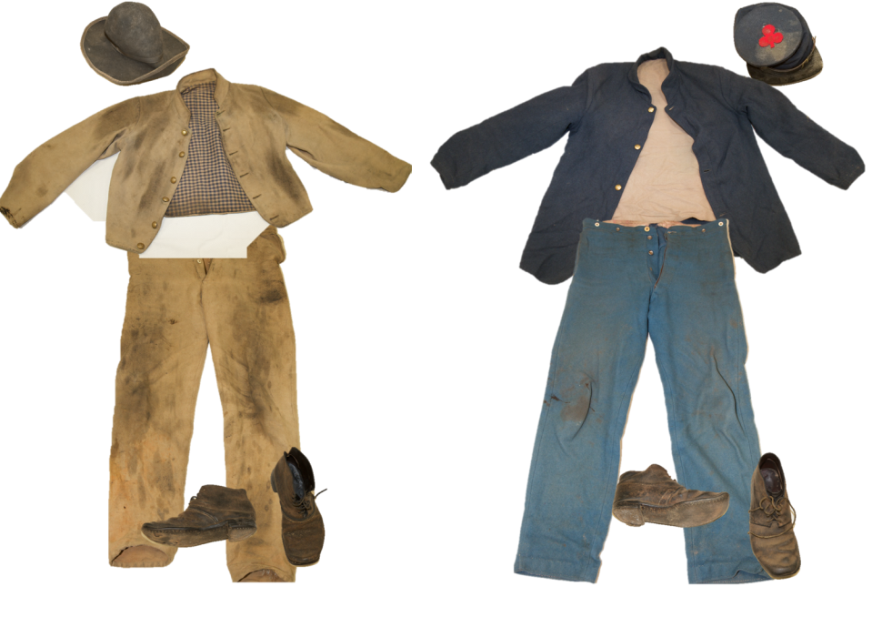
What They Wore
Notes:
On the left - Confederate:
Slouch hat
Shell Jacket
Pants
Brogans (shoes)
On the right - Union:
kepi
Sack Coat
Pants
Brogans (shoes)

Slide 10
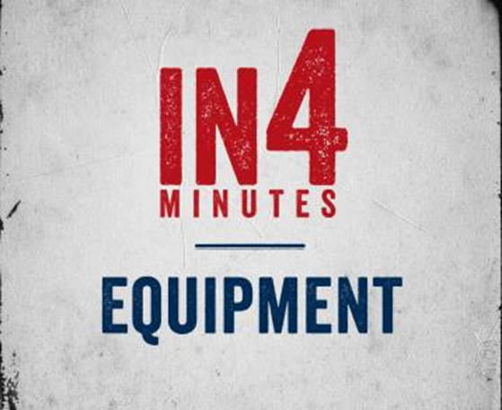
Watch The Video
Notes:
https://www.battlefields.org/learn/videos/equipment-civil-war

Slide 11
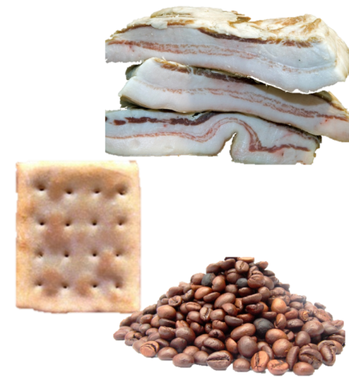
What They Ate
Salt pork, bacon, or beef
Soft bread, flour, cornmeal, or hardtack
Beans or peas
Rice or hominy
Coffee
Tea
Sugar
Vinegar
Molasses
Notes:
Discussion:
How do you think this tasted?
Do you think there was always enough food?

Slide 12
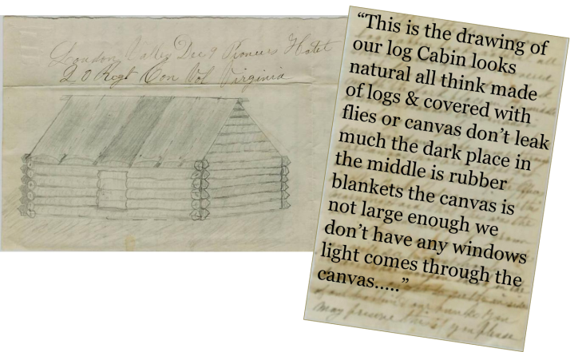
Where They Slept
Notes:
Loudon Valley Dec 9 Pioneers Hotel 20 Regt Con Vol Virginia
“This is the drawing of our log Cabin looks natural all think made of logs & covered with flies or canvas don’t leak much the dark place in the middle is rubber blankets the canvas is not large enough we don’t have any windows light comes through the canvas…..”
Discussion:
What do you think the soldiers stayed in during the warmer months? Answer information – soldiers slept in tents or on the ground
What do you think it was like inside the winter quarters?
Answer information – winter quarters, while looking cozy, were damp and cold. Disease flourished as camp sites became unsanitary with large numbers of men and their waste occupying small areas.
Do you think it was warm or cold?
Why do you think they built such permanent places to stay in the winter and not just use tents like in the summer?
Answer information – there were very few battles in the winter, it was almost impossible to travel once the roads froze. Just like how battles mainly happened during the day they also mainly happened during the warmer months because it was just too logistically and physically difficult.

Slide 13
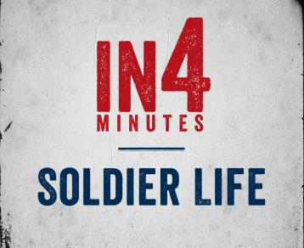
Watch the Video
Notes:
https://www.battlefields.org/learn/videos/soldier-life-during-civil-war

Slide 14
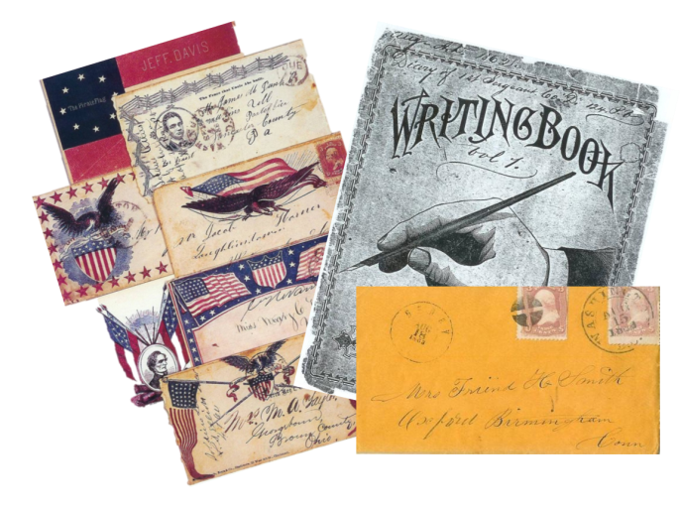
How They Communicated
Notes:
All who knew how to write, wrote letters. During the Civil War letter writing was the only method of personal communication.
Discussion:
Do you think soldiers looked forward to getting mail?
Do you think the soldiers got homesick?

Slide 15
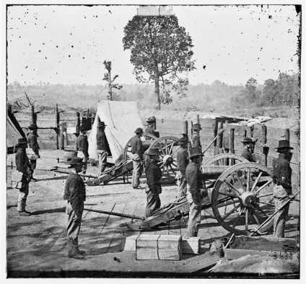
When They Weren’t Fighting
“first thing in the morning is drill, then drill, then drill again. Then drill, drill, a little more drill. Then drill and lastly drill. Between drills, we drill….”
– Union Soldier
Notes:
Soldiers spent the majority of their time in camp drilling, not on the battlefield.
Discussion:
Why were they always drilling?
Answer information - Most of the time soldiers were not fighting battles, rather they were in camp or marching. Drilling kept the men busy during the down-time and prepared them so that they could maneuver under fire.

Slide 16
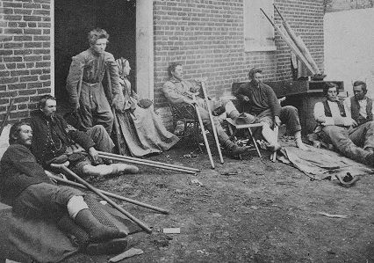
Life and Death

Slide 17
Life and Death
Disease and Hygiene
  Everyone and everything smelled during the Civil War.
  Diarrhea was the greatest killer during the Civil War.
  Of the more than 620,000 soldiers who died in the war, more than 400,000 died of sickness and disease.
Notes:
Discussion:
According to this information, did bullets or sickness kill most of the soldiers?

Slide 18
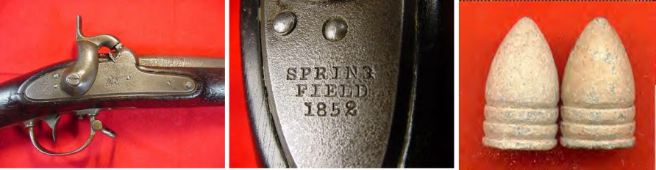
Life And Death
Weapons technology – The rifled musket killed more soldiers than anything else, except disease. It’s effects also created wounds that were difficult to treat
Notes:
There were many types of guns used in the Civil War, but the advent of the rifled musket, widely used during the war, created tremendous casualties. The rifled musket’s large caliber, soft slow moving slug destroyed and pulverized the flesh and bone it tore into. This weapon made amputation the only practical treatment for saving lives.

Slide 19

Watch the Video
Notes:
https://www.battlefields.org/learn/videos/civil-war-medicine

Slide 20
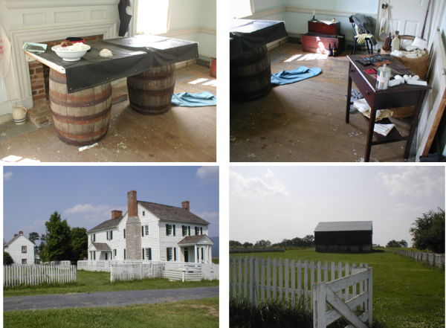
Life and Death
When a battle took place, every structure, house, barn, yard and field, could become a hospital…..
Notes:
Surgeons preferred to operate outside if possible to mitigate the effects of the chloroform and to utilize the light. An operating table was often an unhinged door on top of two barrels.
Discussion:
What do you think happened to the people living inside the homes that became hospitals?
Answer information – sometimes the citizens had already left, sometimes they were forced to leave or stay in an out-of-the-way place.

Slide 21

Watch the Video
Notes:
https://www.battlefields.org/learn/videos/amputations-during-civil-war

Slide 22
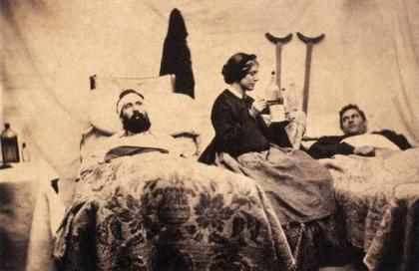
Life and Death
"You have given your boys to die for their country. Now you can give your girls to nurse them.”
-Nurse Mary Stinebaugh
Notes:
Discussion:
Before the Civil War nurses had mostly been men, but during the war women fought to work in the field and contribute to the war effort. There were also women who served as soldiers, they would dress themselves as men and enlist under a male name.

Slide 23
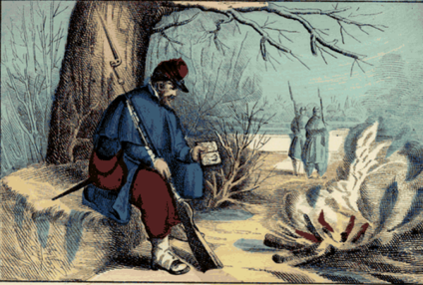
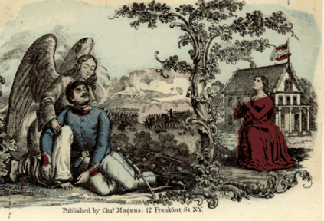
Life and Death
Notes:
Soldiers, North and South, dreamed of returning home safe.

Slide 24
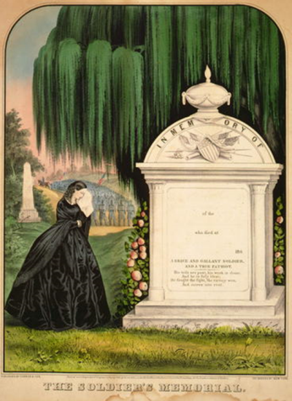
Life and Death
About 2.75 million soldiers fought in the Civil War.
More than 620,000 men died in the war, with disease killing twice as many as those lost in battle.
Notes:
Discussion:
What do you think happened to the country with so many men dying?
Do you think things went back to the way they were before the war? What might have changed?

Slide 25
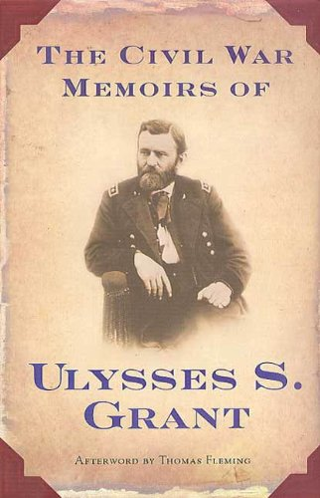
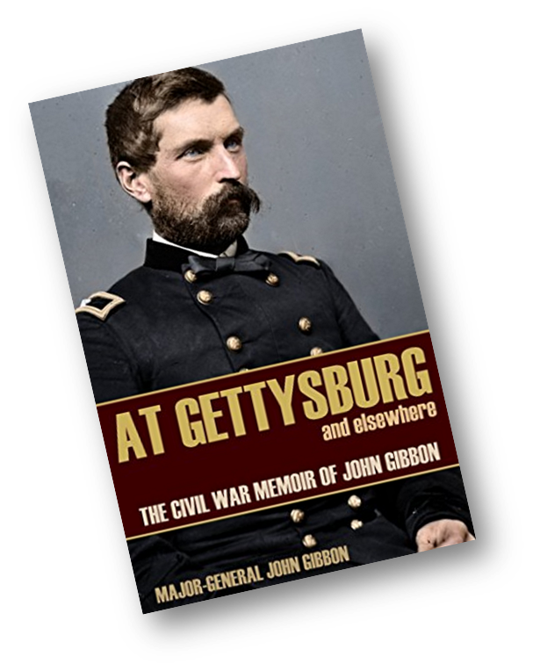
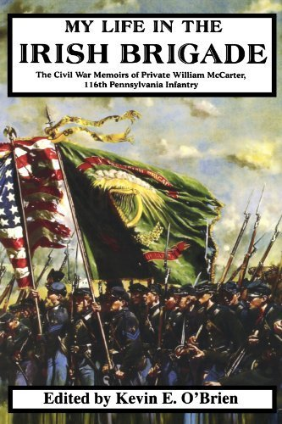
Memories of the War
For those who survived, memories of the war were a part of their everyday life.
Notes:
Soldiers and their families preserved letters, diaries, and photographs. Some even wrote memoirs.
Discussion:
What might a historian learn by reading the letter of a soldier?

Slide 26
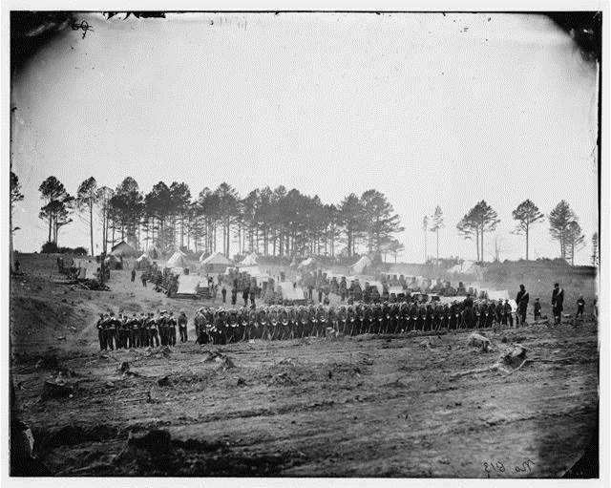
Where Battles Happen

Slide 27
Six Reasons Why Battles Happened in Certain Places
Road Networks
Railroad Networks
Importance of the Area
  Example: The area between Richmond, VA and Washington, DC
Waterways
Topography or Lay of the Land
Reliable Intelligence
Notes:
When there were battles they were fought in certain areas. While sometimes skirmishes were simply a matter of finding the enemy along the way, battles usually occurred where one side was defending something or trying to obtain something important such as a train station, fort on a waterway, or important city. Battles were also fought in certain geographic locations because there were strategic advantages such as high ground or natural barriers.
Railroad networks, road networks, and waterways – important for transportation of troops and supplies.
Waterways – control of certain waterways will prevent the enemy from moving through or beyond that waterway.
Importance of the space – capturing the capital of the enemy will almost certainly end the war. The Army of Northern Virginia and The Army of the Potomac were constantly trying to move around one another to capture the opposing army’s capital. Both armies had to be on the offense and defense.
Topography – geographically a certain location will offer more for a battle such as a river, high ground, natural barrier or covering.
Intelligence – reliable information on the location of the enemy was rare and could lead to a battle.

Slide 28
